Slide 1
Multilevel Parallelism for Computational Engineering
Preconditioning via
Parallel (I)LU Factorization
Stephen Wood

Slide 2


Acknowledgements
Chad Burdyshaw of JICS
Mitchel Horton of JICS
Bobby Philip of ORNL
Ryan Glasby of JICS
Taylor Erwin of JICS
Hartwig Anzt of ICL
Support from
AFOSR CoDAASH, NASA CFD 2030 Solver project
ECP PEEKS, and ECP Exa-PAPI

Slide 3
Outline
Acknowledgements
Motivation
Hardware evolution
Serial algorithms
Path to sparse
Dense ParLU implementation
Accuracy
Performance
Sparse
PariLU implementation
Accuracy
Performance
Influence on MKL’s GMRES
Future work

Slide 4
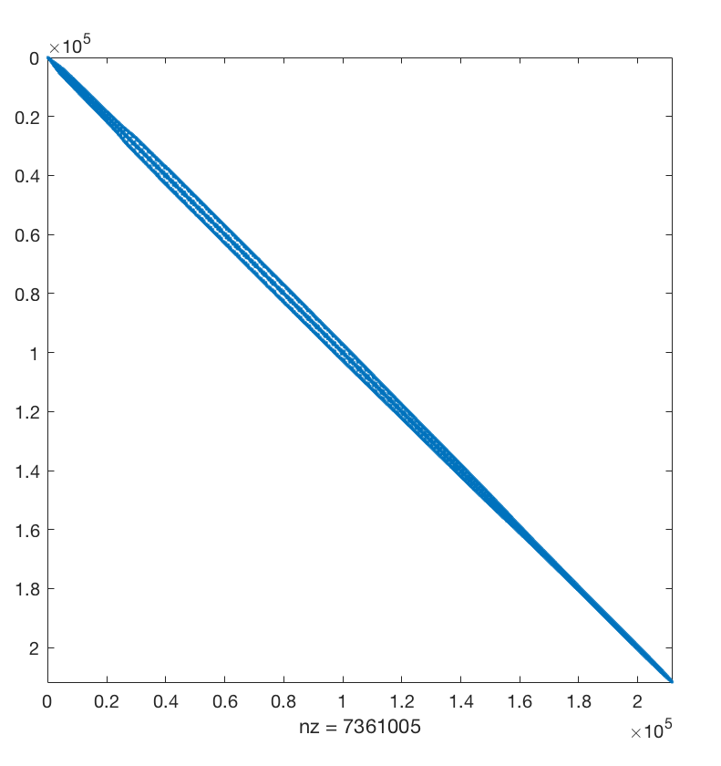
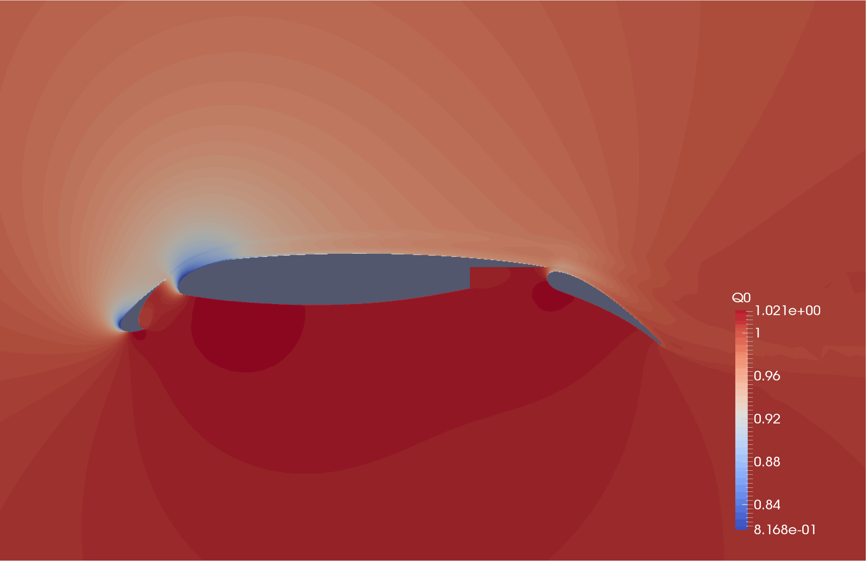
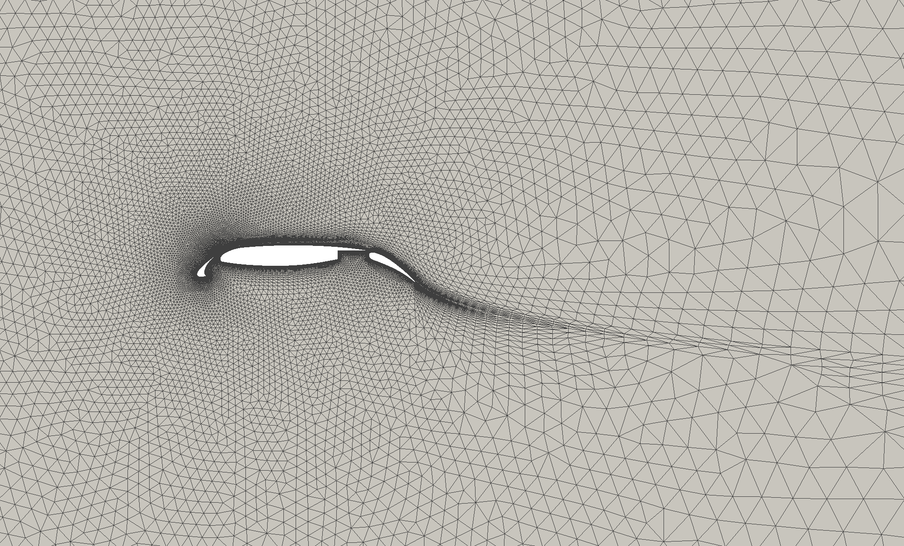
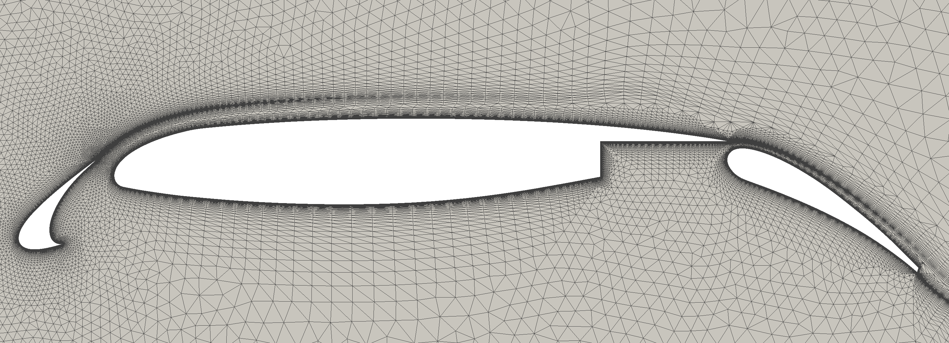
Motivation
Trend towards “fatter” nodes
Larger subdomains
Improved preconditioning
Improved solver path – less GMRES search directions possible
Reduced communication

Slide 5
30p30n Multi-element Airfoil
Non-dimensional density contours around a 30p30n multi-component airfoil at Mach 0.2, angle of attack 16 degrees, and Re = 9.0x10^6 (based on the mean cord length).
Glasby, R., Erwin, J., Stefanski, D., Allmaras, S., Galbraith, M., Anderson, W., and Nichols, R., "Introduction to COFFE: The Next-Generation HPCMP CREATETM-AV CFD Solver," AIAA: 54th Aerospace Sciences Meeting, 2016, AIAA 2016-0567
Second Workshop on Benchmark problems for Airframe Noise Computations (BANC-II), 2012, https://info.aiaa.org/tac/ASG/FDTC/DG/BECAN_files_/BANCII.htm

Slide 6
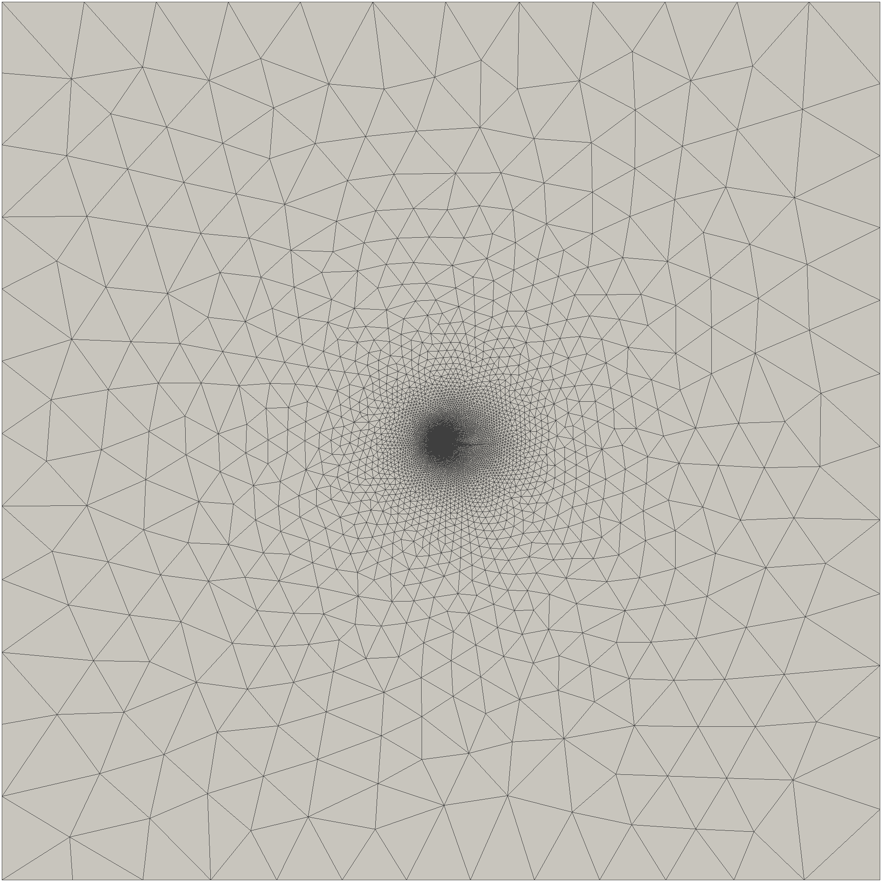
30p30n Multi-element Airfoil
Zoom 1 of 30p30n simulation domain.
Mesh of the entire 30p30n simulation domain.
Zoom 2 of 30p30n simulation domain.

Slide 7
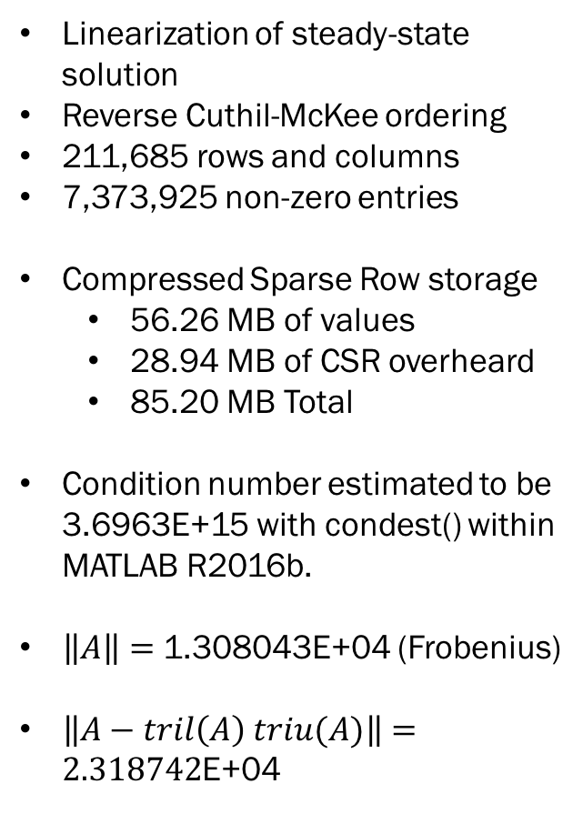
30p30n Multi-element Airfoil
Linearization of steady-state solution
Reverse Cuthil-McKee ordering
211,685 rows and columns
7,373,925 non-zero entries
Compressed Sparse Row storage
56.26 MB of values
28.94 MB of CSR overheard
85.20 MB Total
Condition number estimated to be 3.6963E+15 with condest() within MATLAB R2016b.
$\left\|A\right\|=$ 1.308043E+04 (Frobenius)
$\left\|A−tril\left(A\right) triu(A)\right\|=2.318742$E+04
Sparsity plot of 30p30n matrix.
Notes:
Band width is 900 x 211685 rows = 190,516,500 nz, 0.4252 % sparse ; 25.8365 times larger 1,453.6 MB

Slide 8
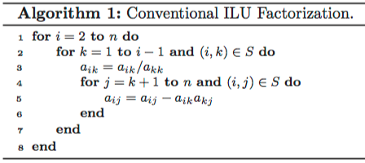
(I)LU Factorization
Preconditioner for poorly conditioned matrices
Sparse matrices (volume)
Dense matrices (surfaces of some implementations)
Gaussian Elimination
Serial algorithm
Arithmetic intensity 0.083 flops/byte
http://www.cc.gatech.edu/~echow/pubs/parilu-sisc.pdf

Slide 9
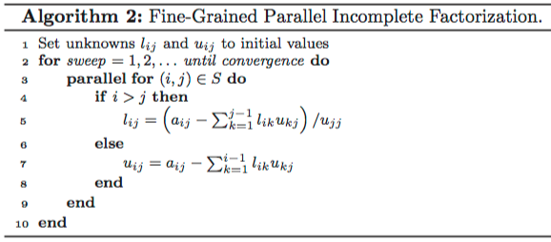
Chow and Patel 2015 FINE-GRAINED PARALLEL INCOMPLETE LU FACTORIZATION
Parallel Algorithm
View Gaussian Elimination as system of equations
Several possible work sharing patterns
Arithmetic intensity 0.123 flops/byte
http://www.cc.gatech.edu/~echow/pubs/parilu-sisc.pdf

Slide 10
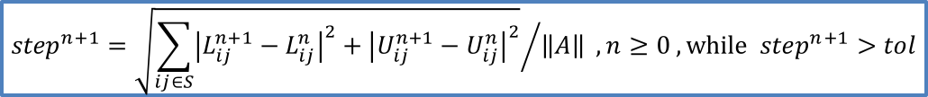
Chow and Patel 2015 FINE-GRAINED PARALLEL INCOMPLETE LU FACTORIZATION
Parallel Algorithm
View Gaussian Elimination as system of equations
Several possible work sharing patterns
Arithmetic intensity 0.123 flops/byte
$${step}^{n+1}={\sqrt{\sum_{ij∈S}{{\left|L_{ij}^{n+1}−L_{ij}^{n}\right|}^{2}+{\left|U_{ij}^{n+1}−U_{ij}^{n}\right|}^{2}}}}/{\left\|A\right\|} , n≥0 , while {step}^{n+1}>tol$$
http://www.cc.gatech.edu/~echow/pubs/parilu-sisc.pdf

Slide 11
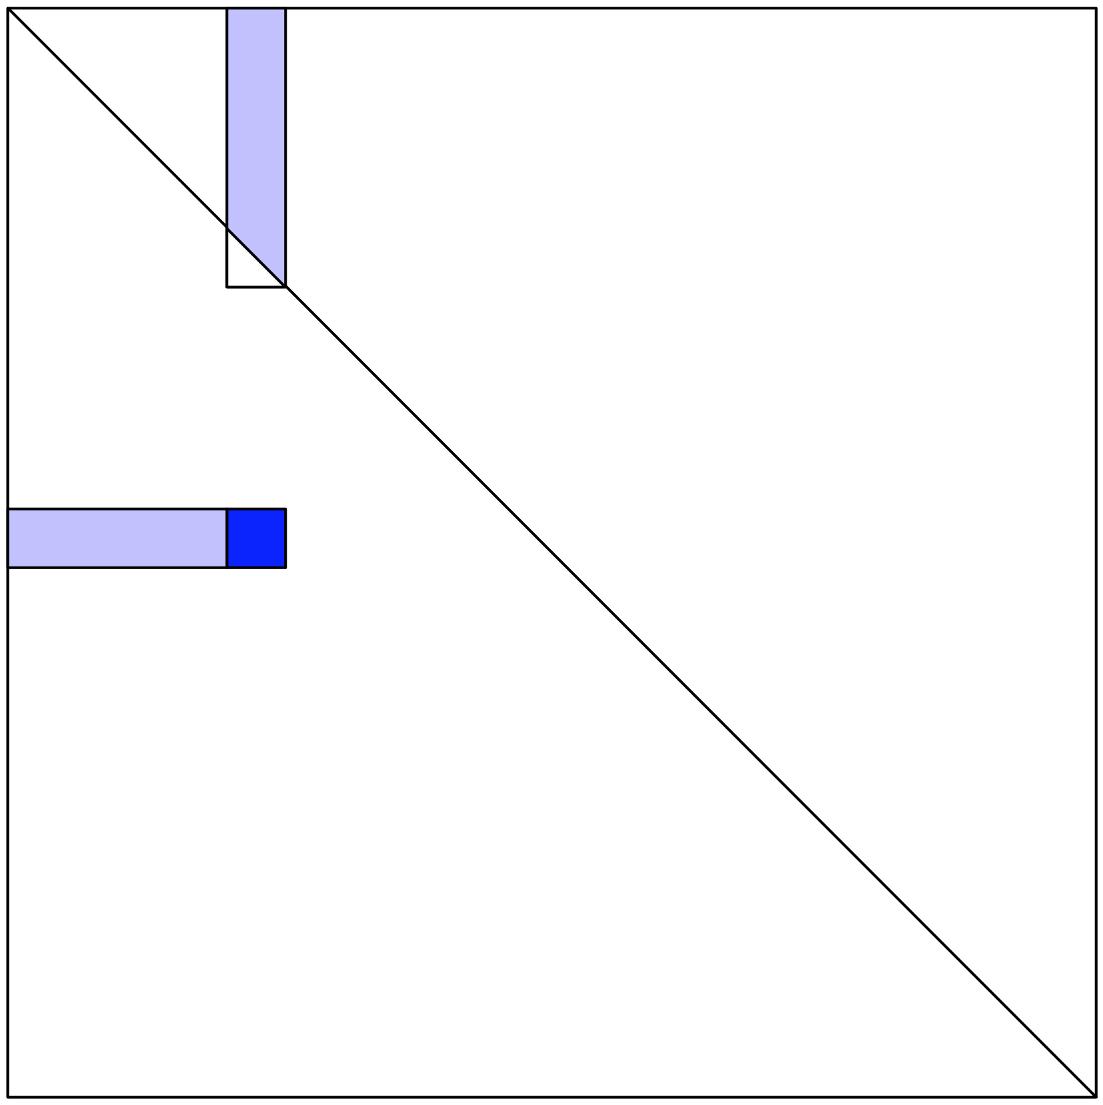
Work sharing patterns

Slide 12
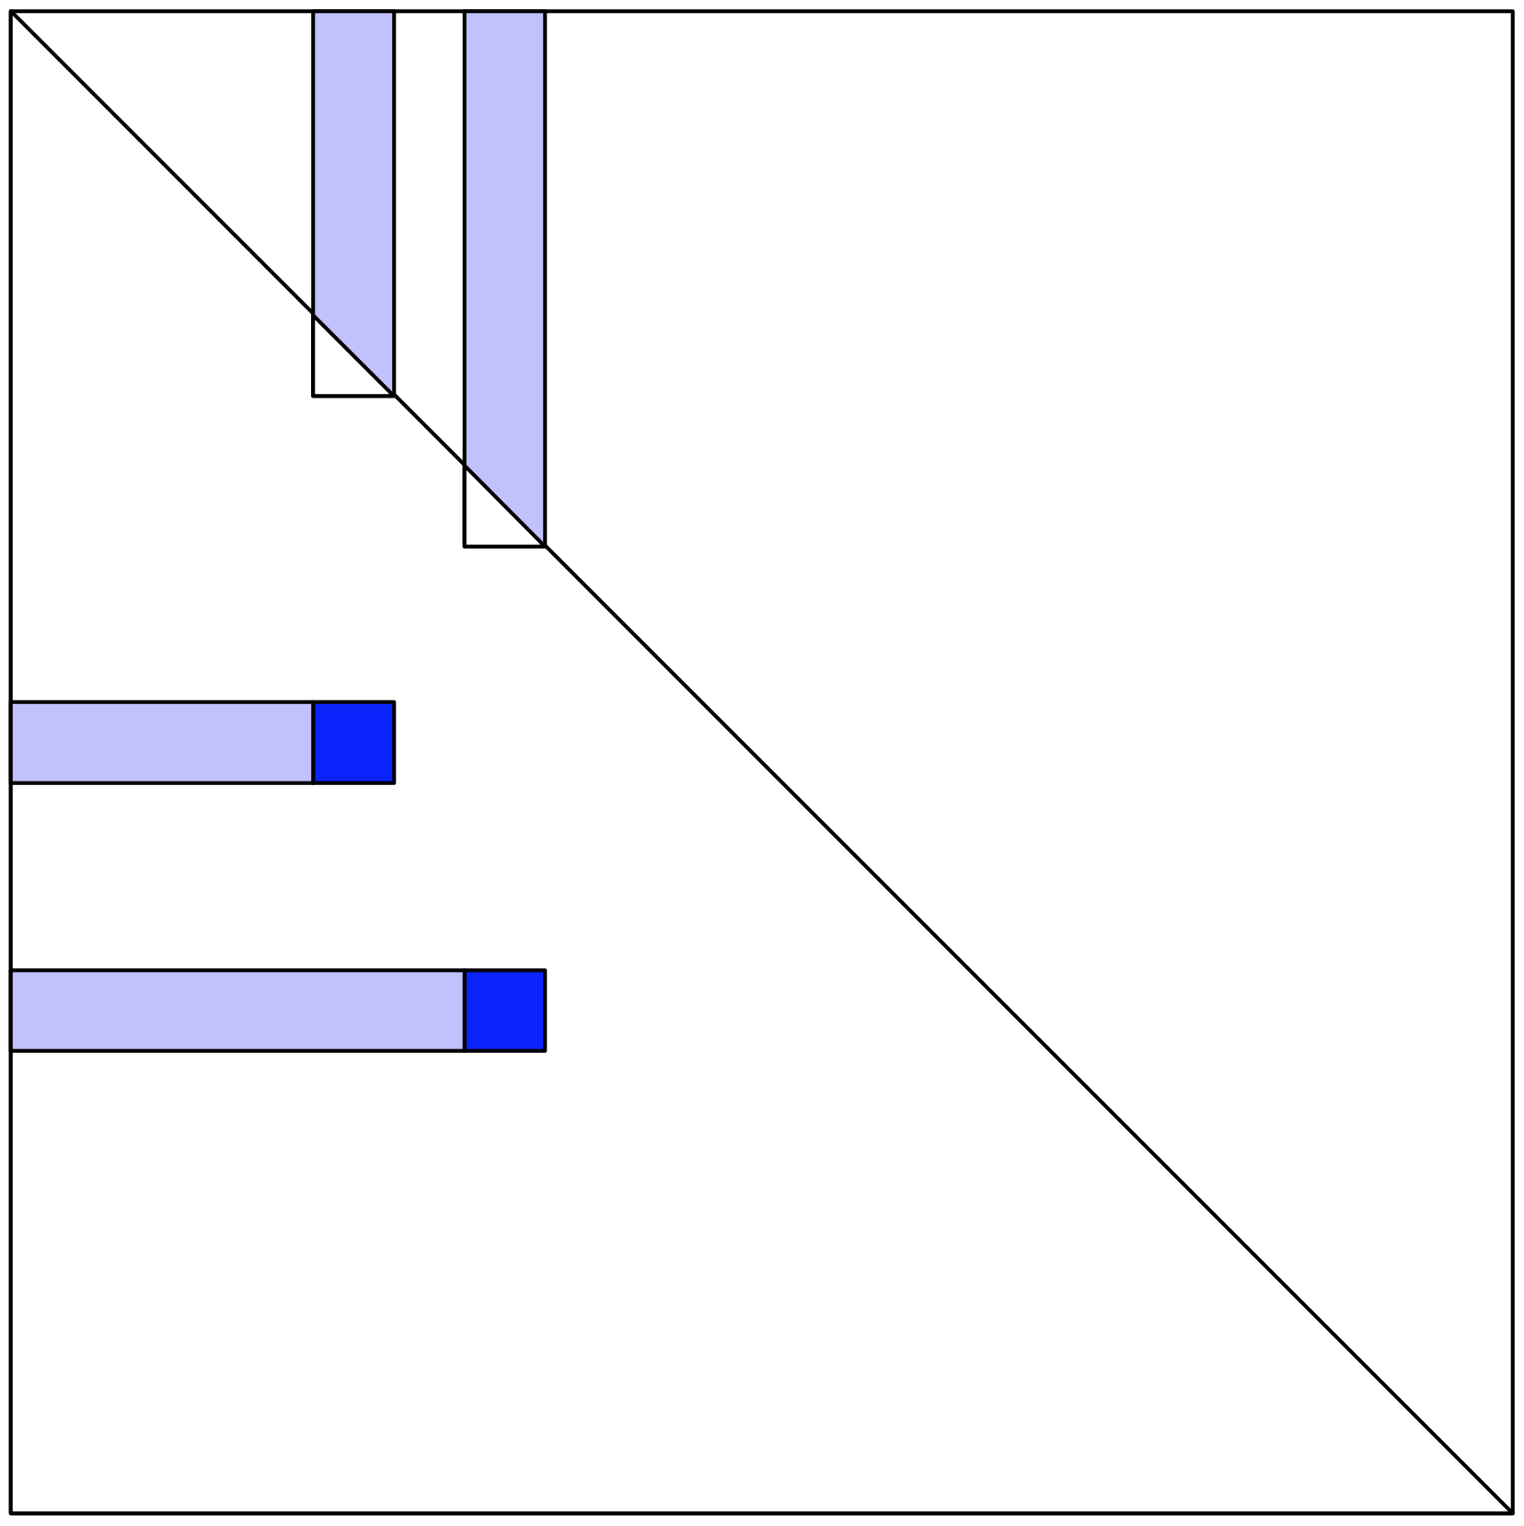
Work sharing patterns

Slide 13
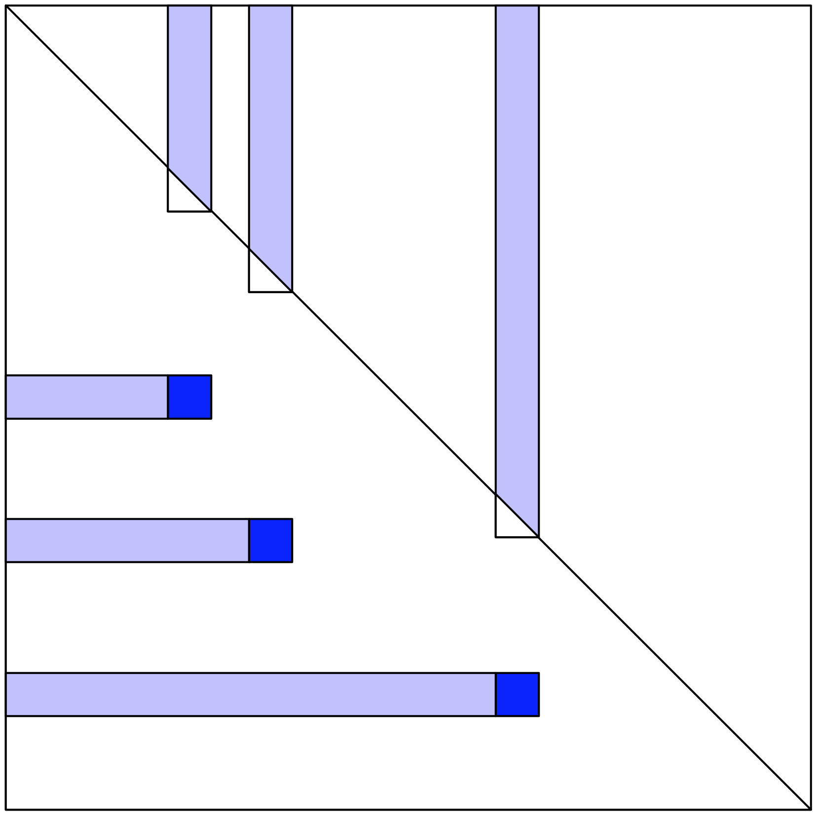
Work sharing patterns

Slide 14
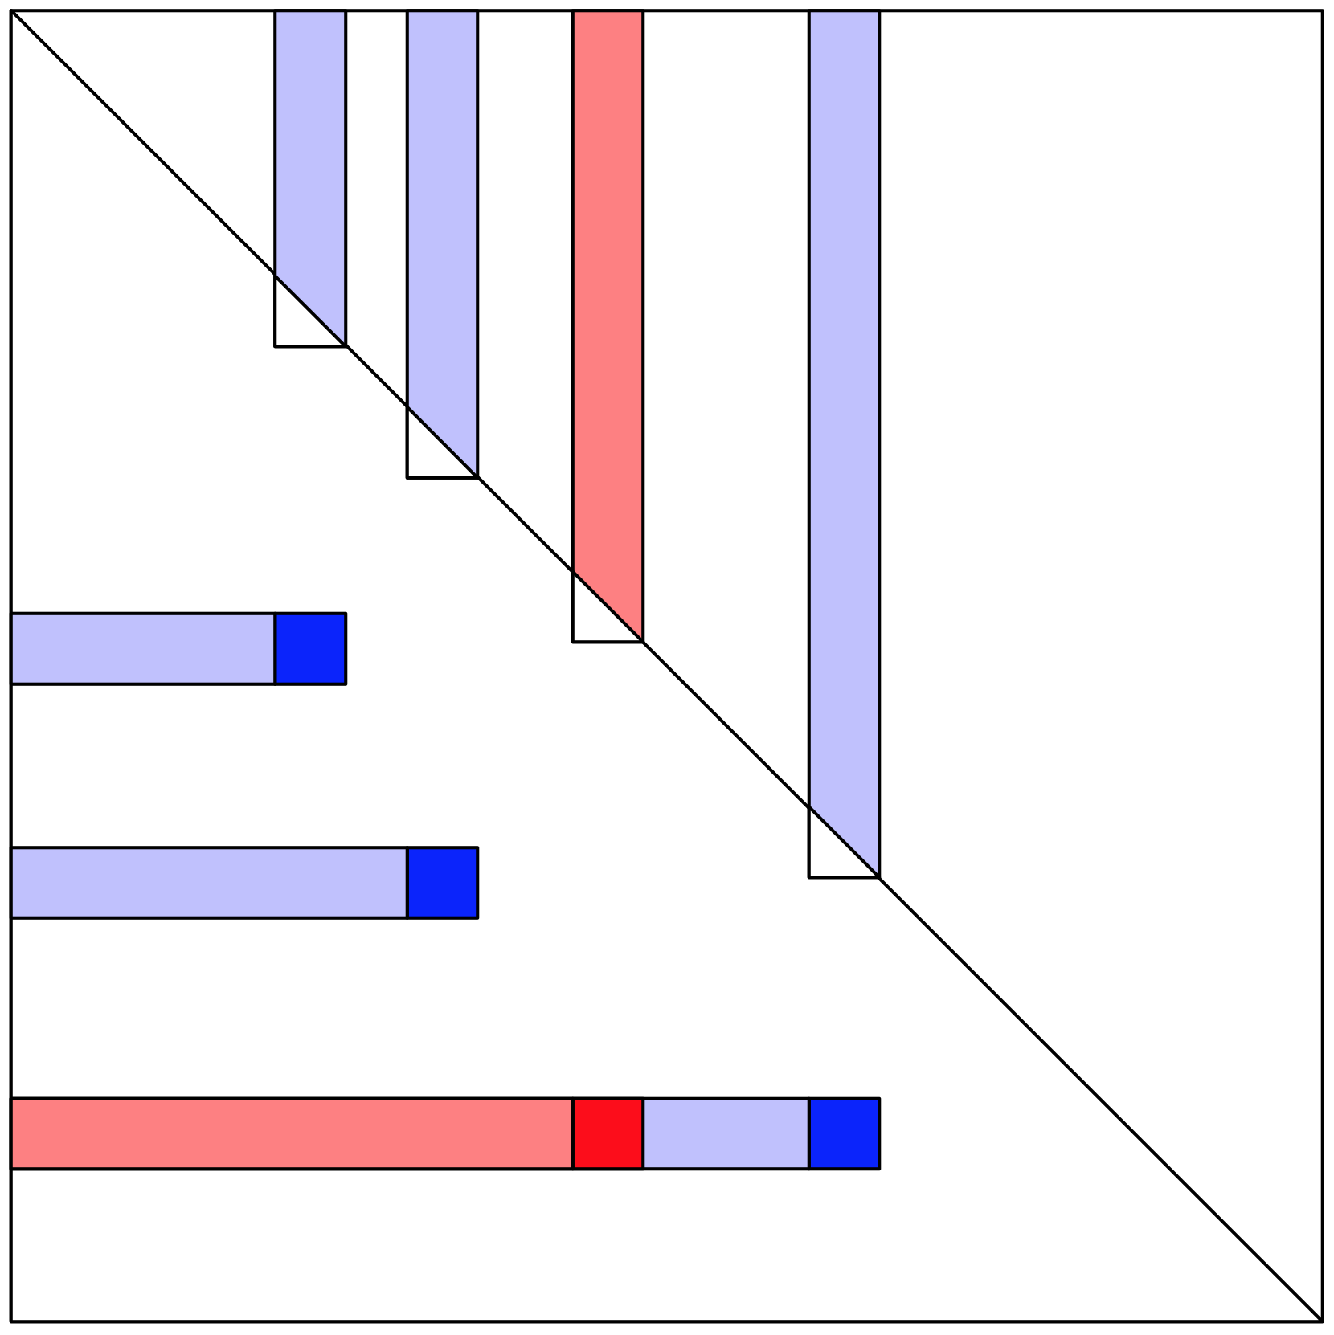
Work sharing patterns

Slide 15
Path to sparse
Climbing the levels of BLAS
Multiplication
Level 1 : Dot products
Level 2 : Matrix – vector products
Level 3 : Matrix – Matrix products

Slide 16
Stream HPC benchmark on Beacon
Intel® Xeon® E5-2670
16 cores (2x8), 2.6GHz
L1 32 KB
L2 256 KB
L3 20 MB
Peak 332.8 Gflops/s DP
Peak 102 GB/s
SIMD 4 DP
Intel® Xeon Phi™7250
272 cores (68x4), 1.40 GHz
MCDRAM 16 GB
DDR4 384 GB
Peak 3.05 Tflops/s DP
MCDRAM Peak 490 GB/s (flat mode)
SIMD 8 DP
 | Best MB/s
 | Xeon | Phi
Copy | 54,584.5 | 272,398.9
Scale | 54,691.8 | 336,838.5
Add | 55,823.6 | 250,850.8
Triad | 56,510.3 | 430,989.6
http://icl.cs.utk.edu/hpcc/
https://software.intel.com/en-us/articles/optimizing-memory-bandwidth-in-knights-landing-on-stream-triad

Slide 17
Recipes
Haswell
source /opt/intel/compilers_and_libraries/linux/bin/compilervars.sh intel64
source /opt/intel/compilers_and_libraries/linux/mkl/bin/mklvars.sh intel64
icpc -Wall -g -O3 -fp-model precise -fp-model source -qopenmp –xAVX
numactl -m 1 --interleave=all ./test_solve_pariLU0_MKL_FGMRES
Knights Landing
source /opt/intel/compilers_and_libraries/linux/bin/compilervars.sh intel64
source /opt/intel_mkl2017/compilers_and_libraries/linux/bin/compilervars.sh intel64
icpc -Wall -g -O3 -fp-model precise -fp-model source -qopenmp -xMIC-AVX512 -lmkl_intel_lp64 -lmkl_intel_thread -lmkl_core -liomp5 -lpthread -lstdc++ -lm -ldl
numactl -m 1 --interleave=all ./test_solve_pariLU0_MKL_FGMRES

Slide 18
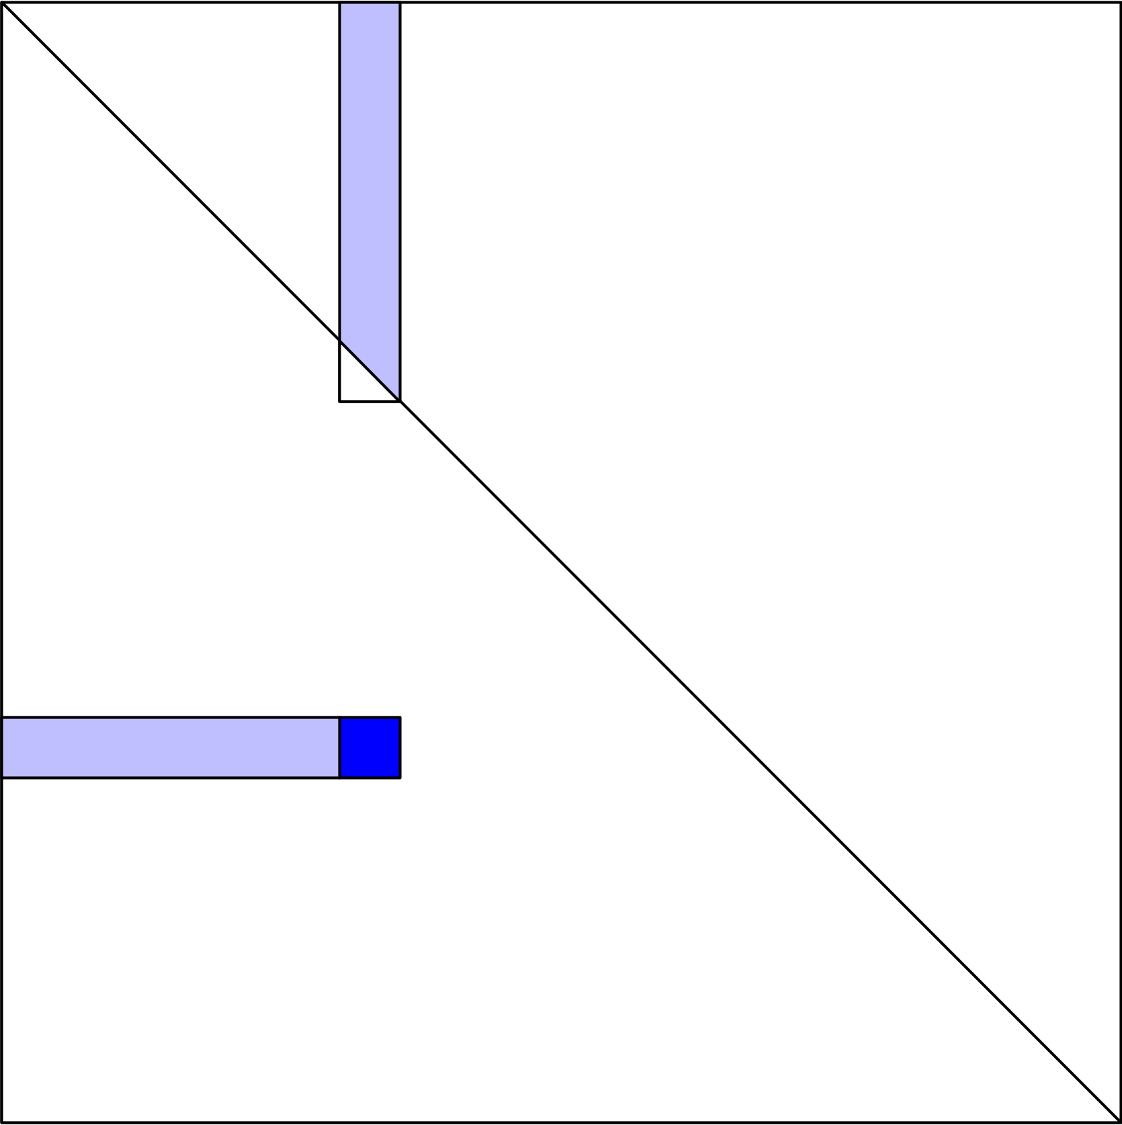
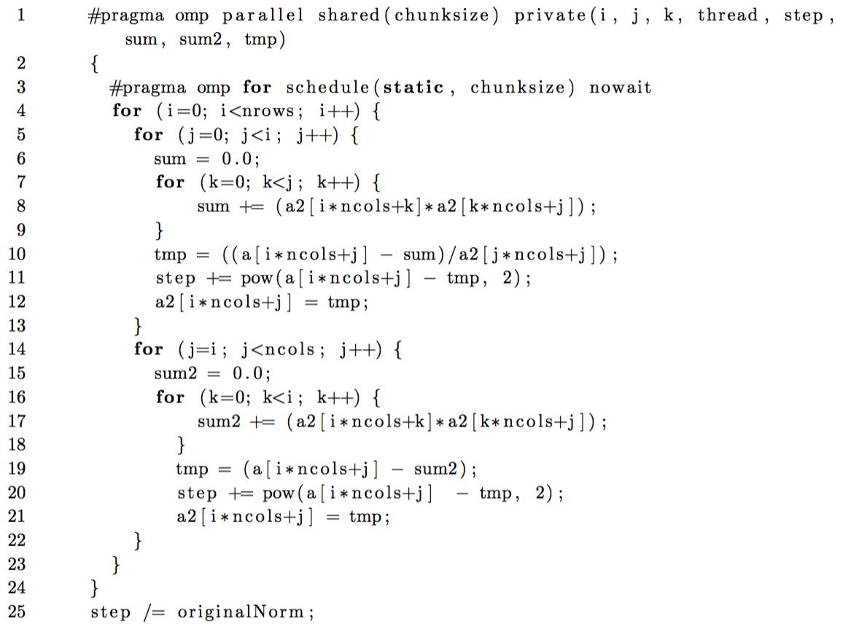
Basic Implementation
“Sweep” until step < 1⁻¹⁰

Slide 19
Basic Implementation
“Sweep” until step < 1⁻¹⁰

Slide 20
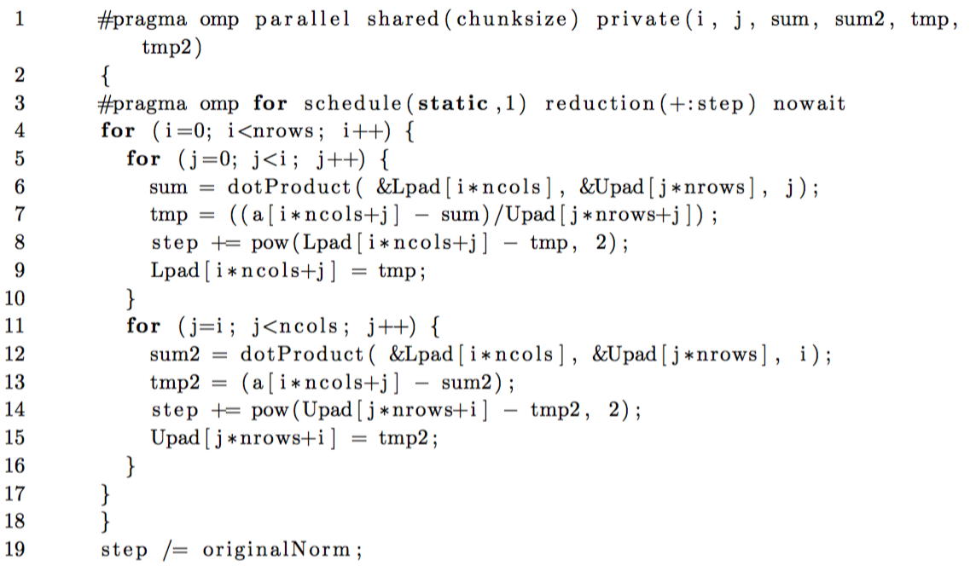
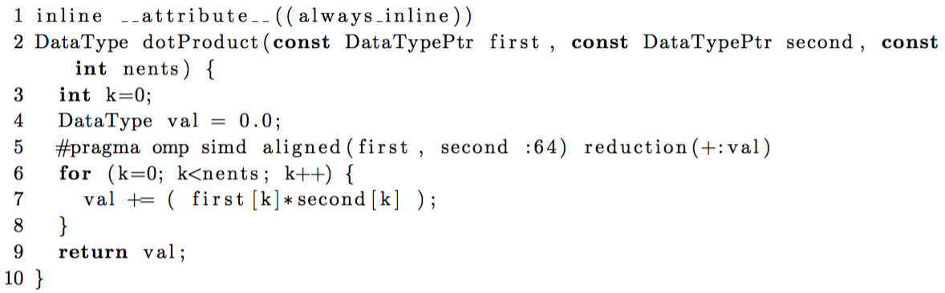
Results : Authored dotProduct()

Slide 21
Results : Authored dotProduct()

Slide 22
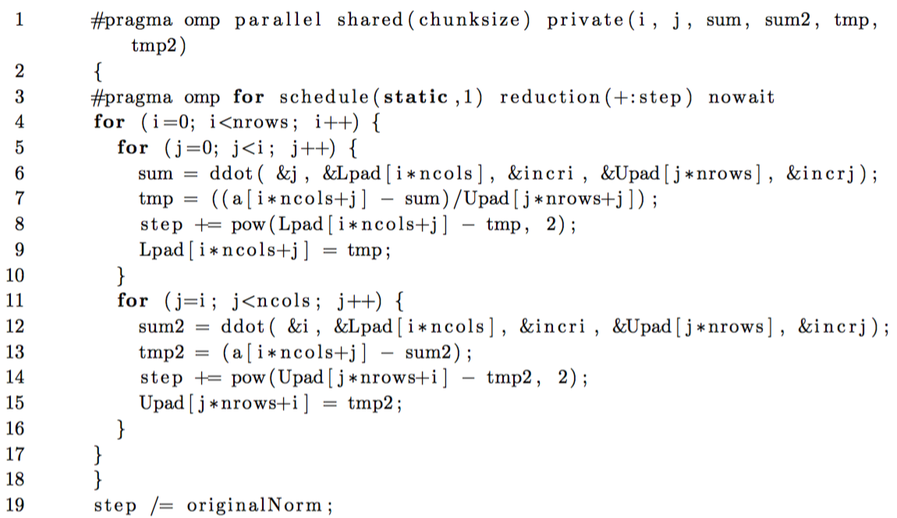
Results : MKL ddot()

Slide 23
Results : MKL ddot()

Slide 24
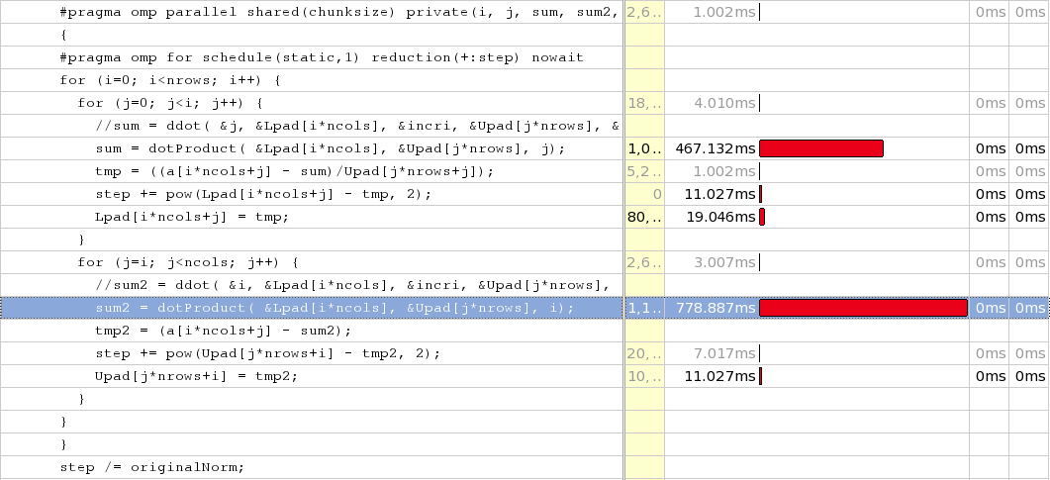
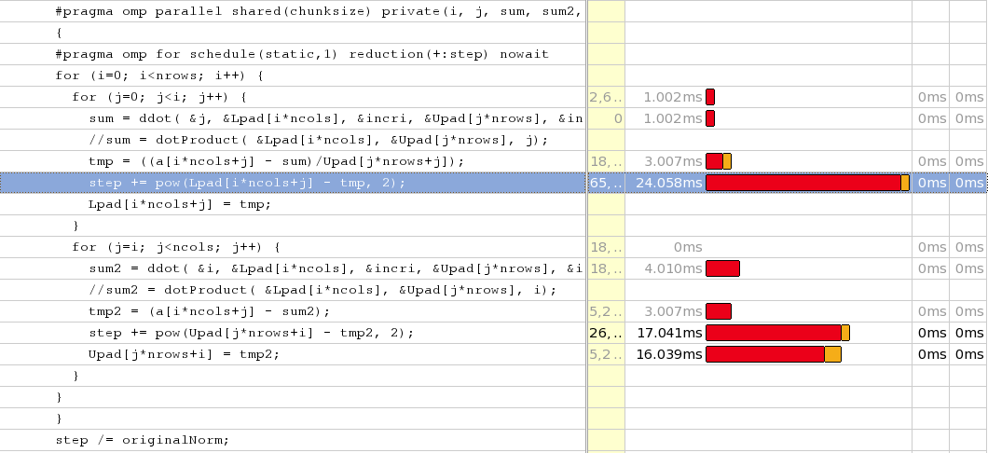
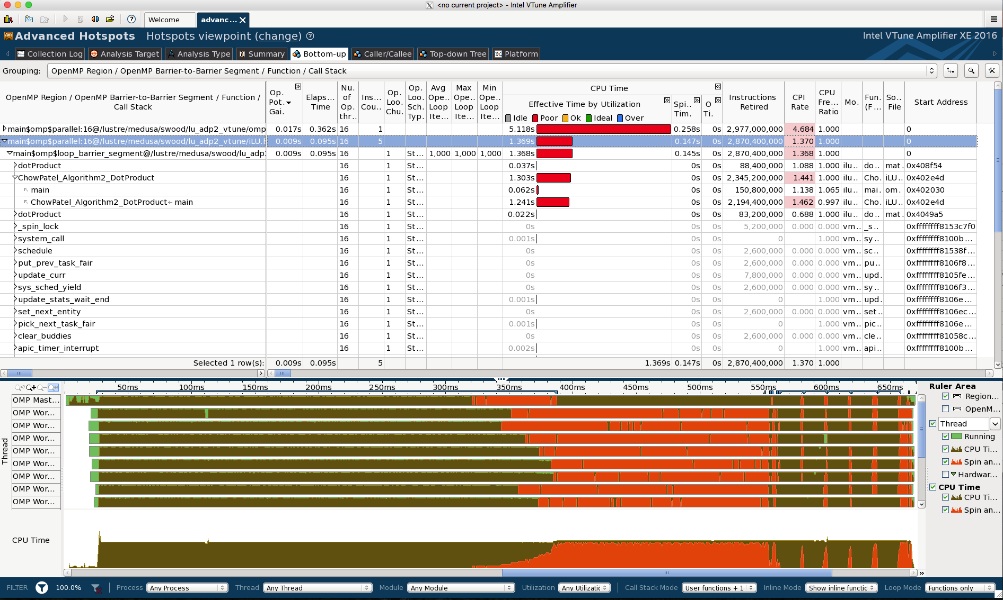
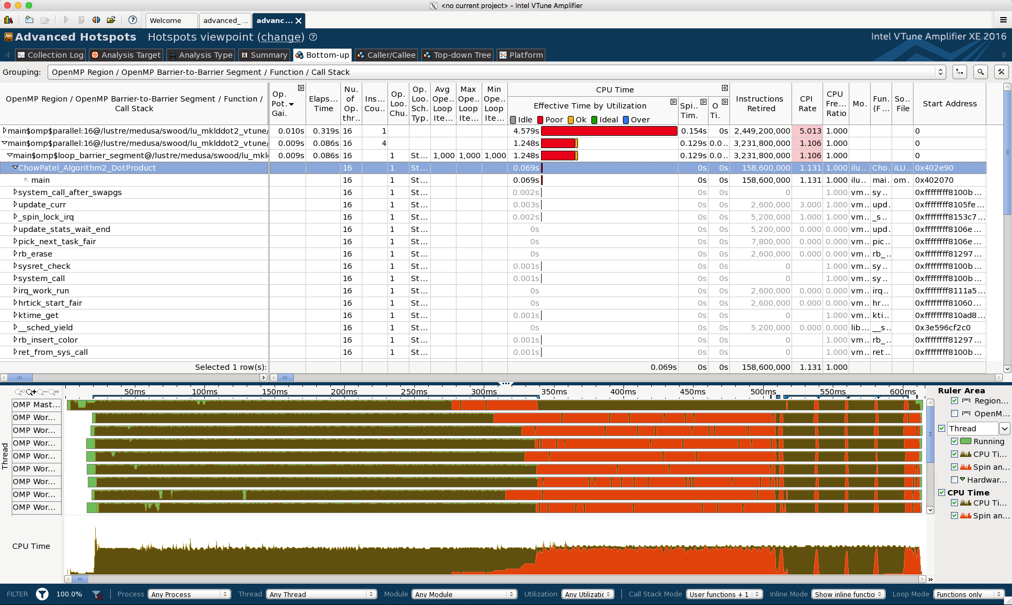
VTune
Authored Dot Product
MKL ddot()
789 ms
24.058 ms

Slide 25

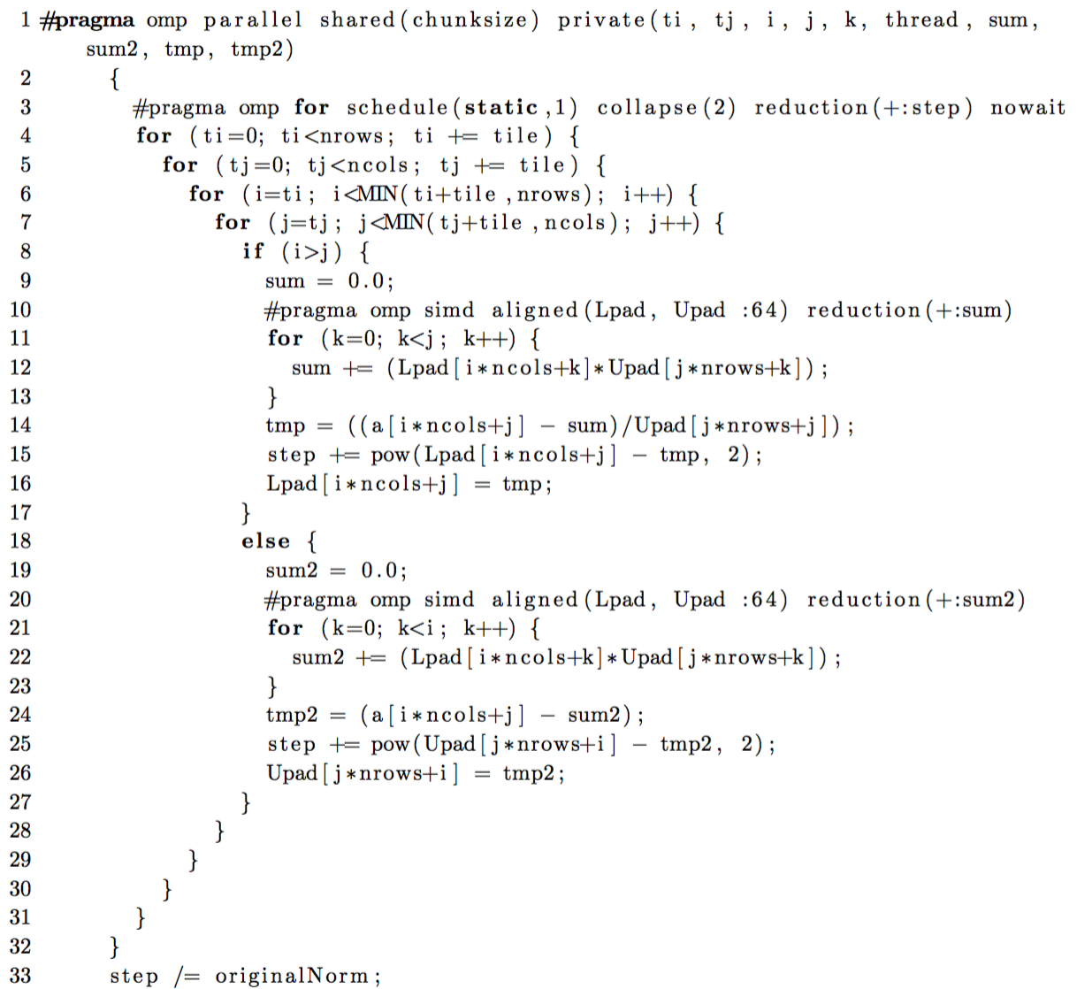
Results : Tiled (120x120)

Slide 26
Results : Tiled (120x120)

Slide 27
Results : Tiled (40x40)

Slide 28
Results : Tiled MKL ddot() (40x40)

Slide 29
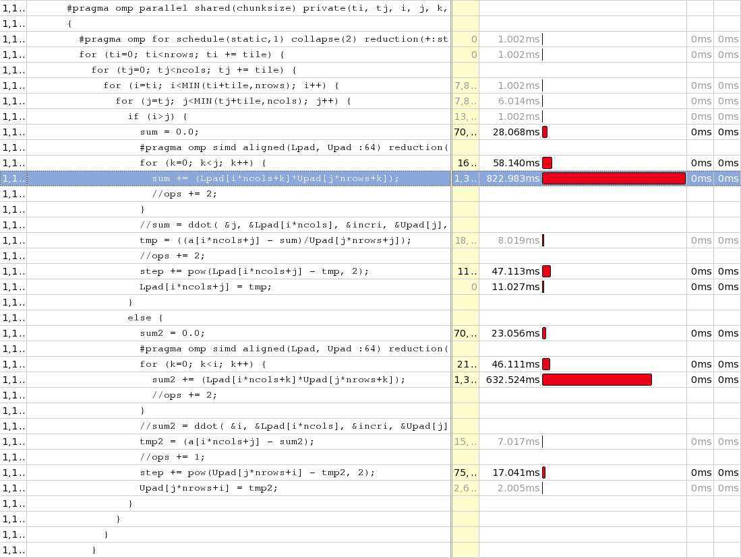
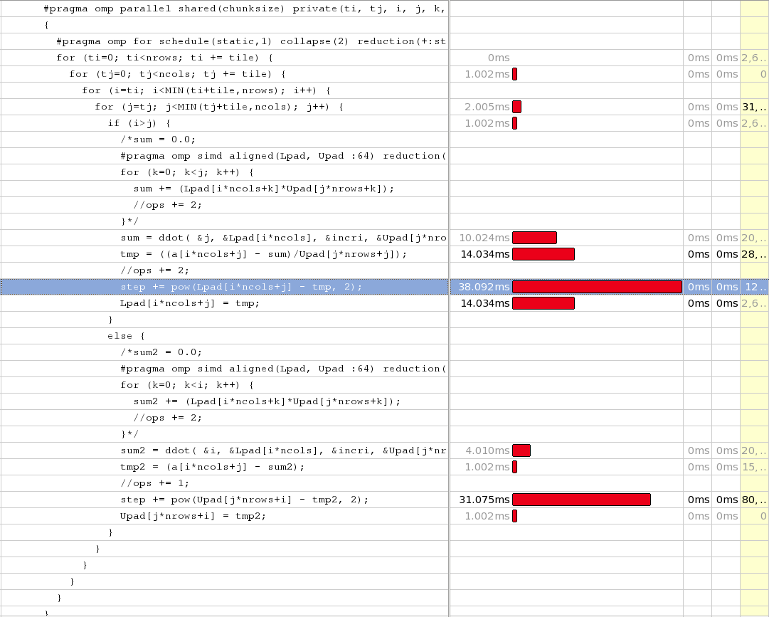
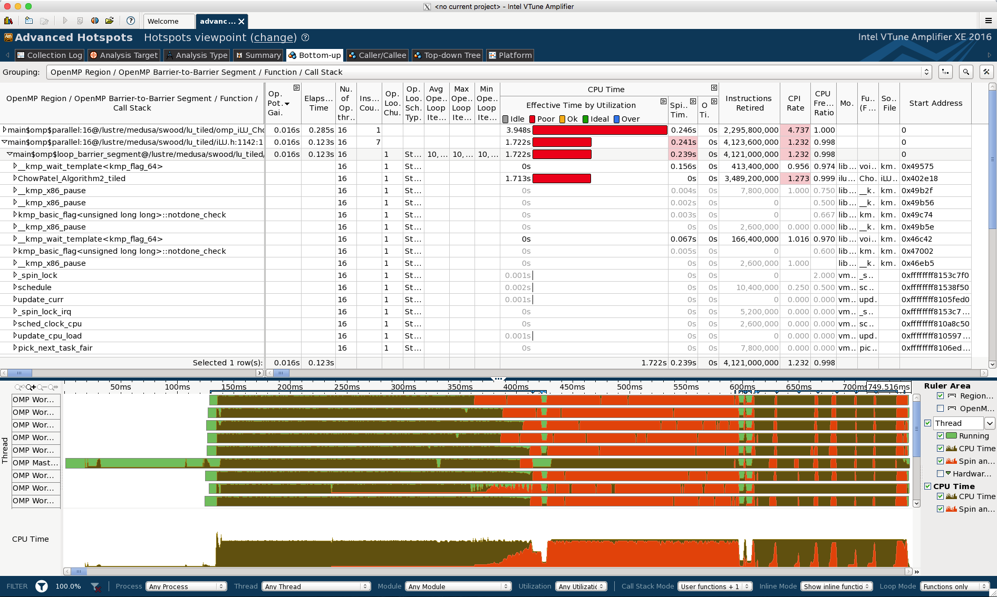
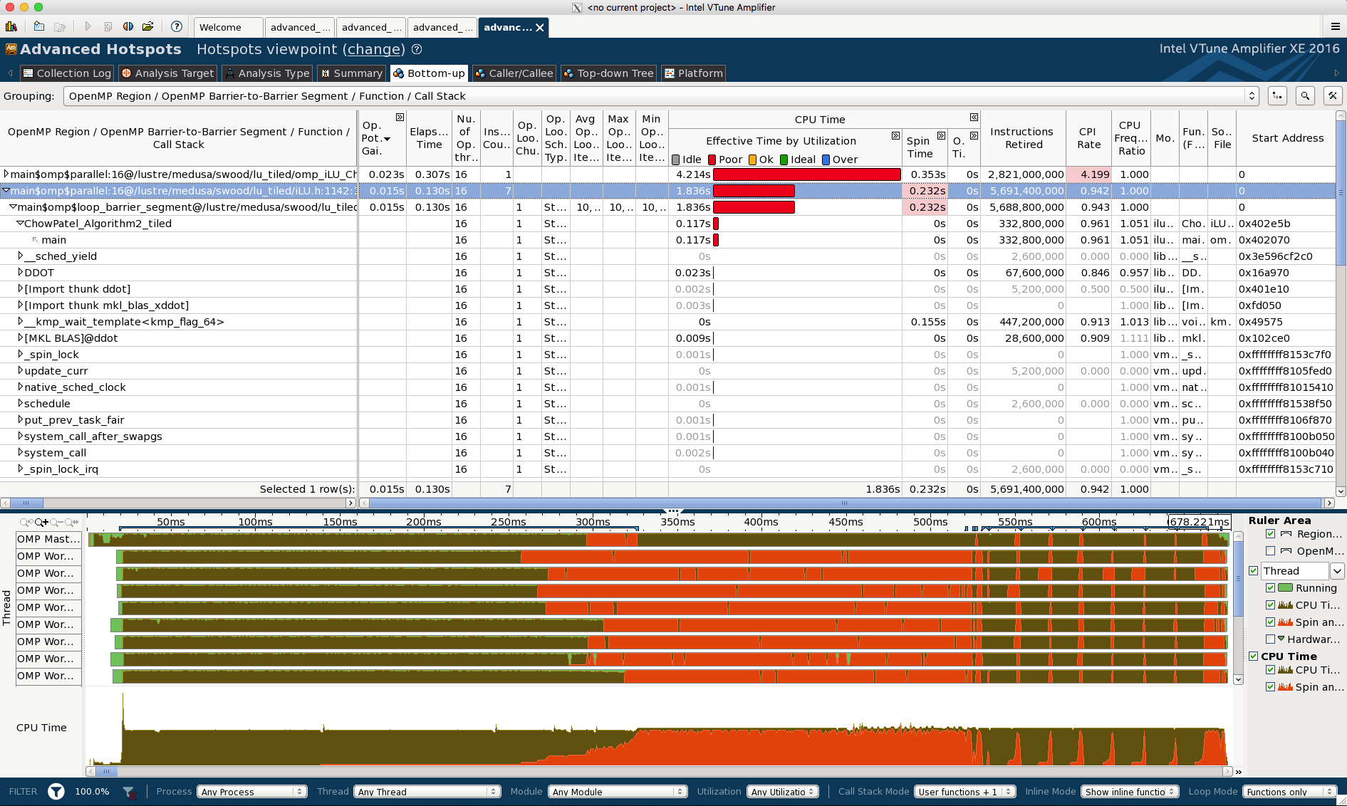
VTune
Tiled (40x40)
Tiled MKL ddot() (40x40)
823.983 ms
38.092 ms

Slide 30
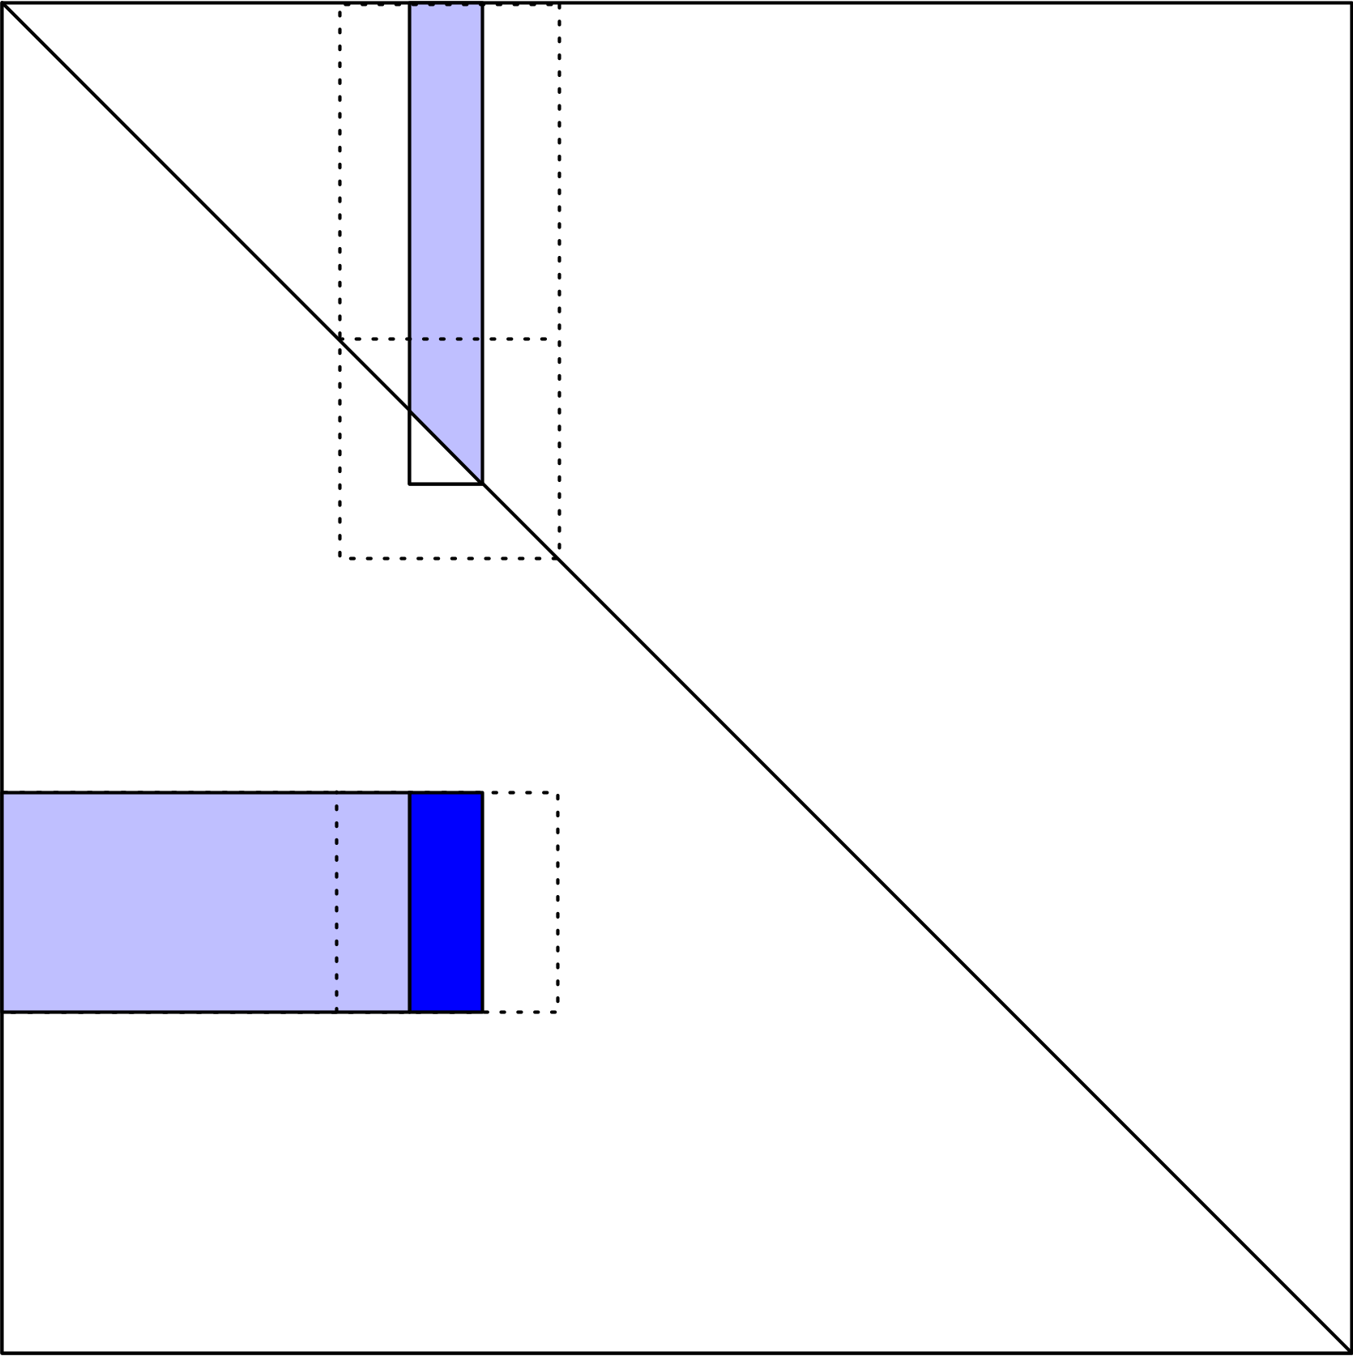
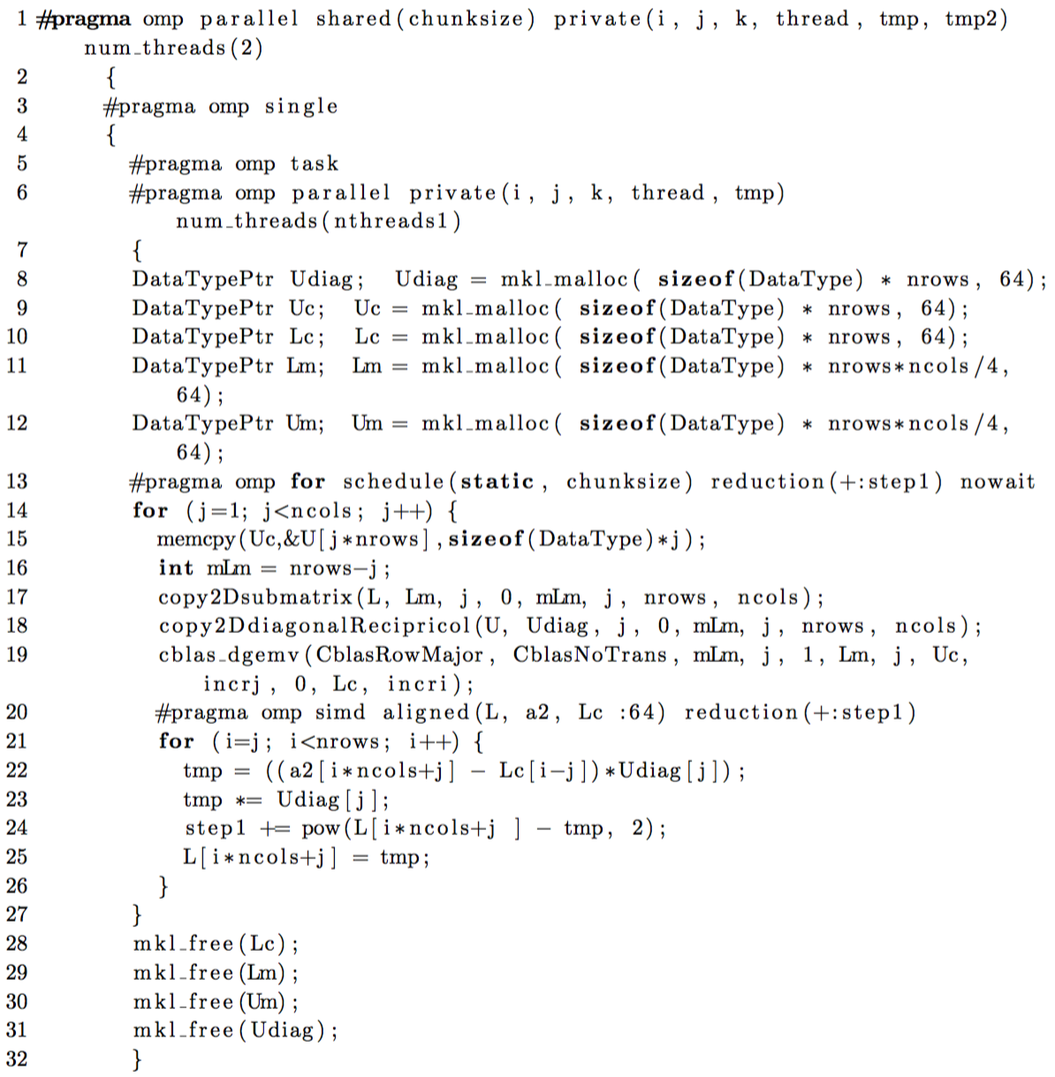
Results : MKL dgemv()

Slide 31
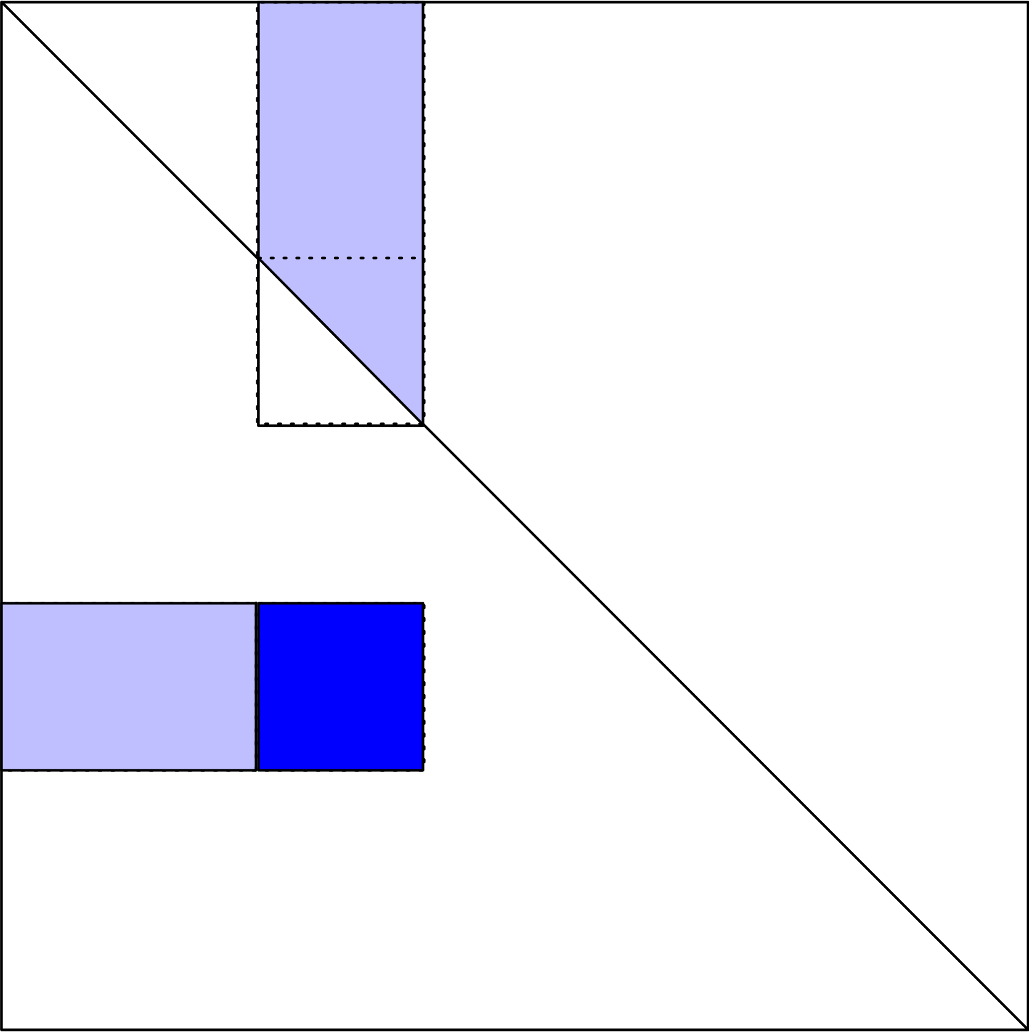
Results : MKL dgemm()

Slide 32
Results : MKL dgemm()
71% of peak performance
Increasing concurrency:
2x work
at
~3.37x speed
= 40.7% factorization
time

Slide 33
Sparse
Subtle patterns with significant consequences
A0 : 7,373,925 nz, 0.0165 % sparse
A1 : 9,672,325 nz, 0.0216 % sparse
A2 : 13,586,425 nz, 0.0303 % sparse
A3 : 17,741,775 nz, 0.0396 % sparse
211685 rows

Slide 34
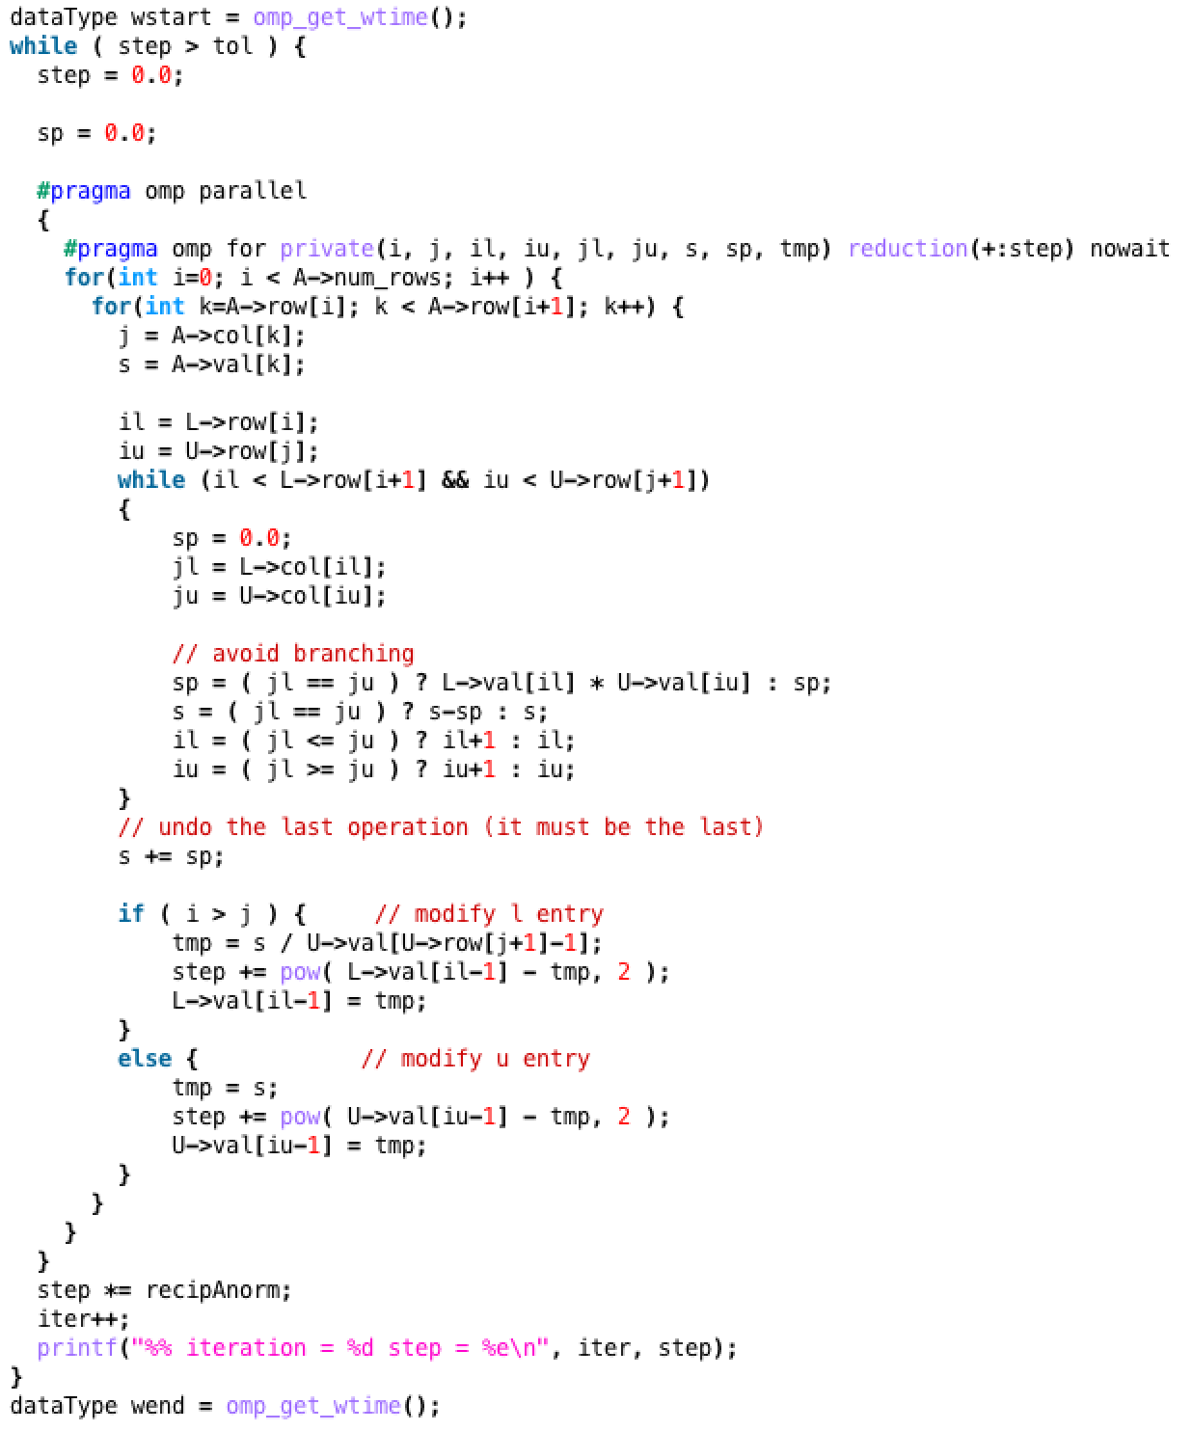
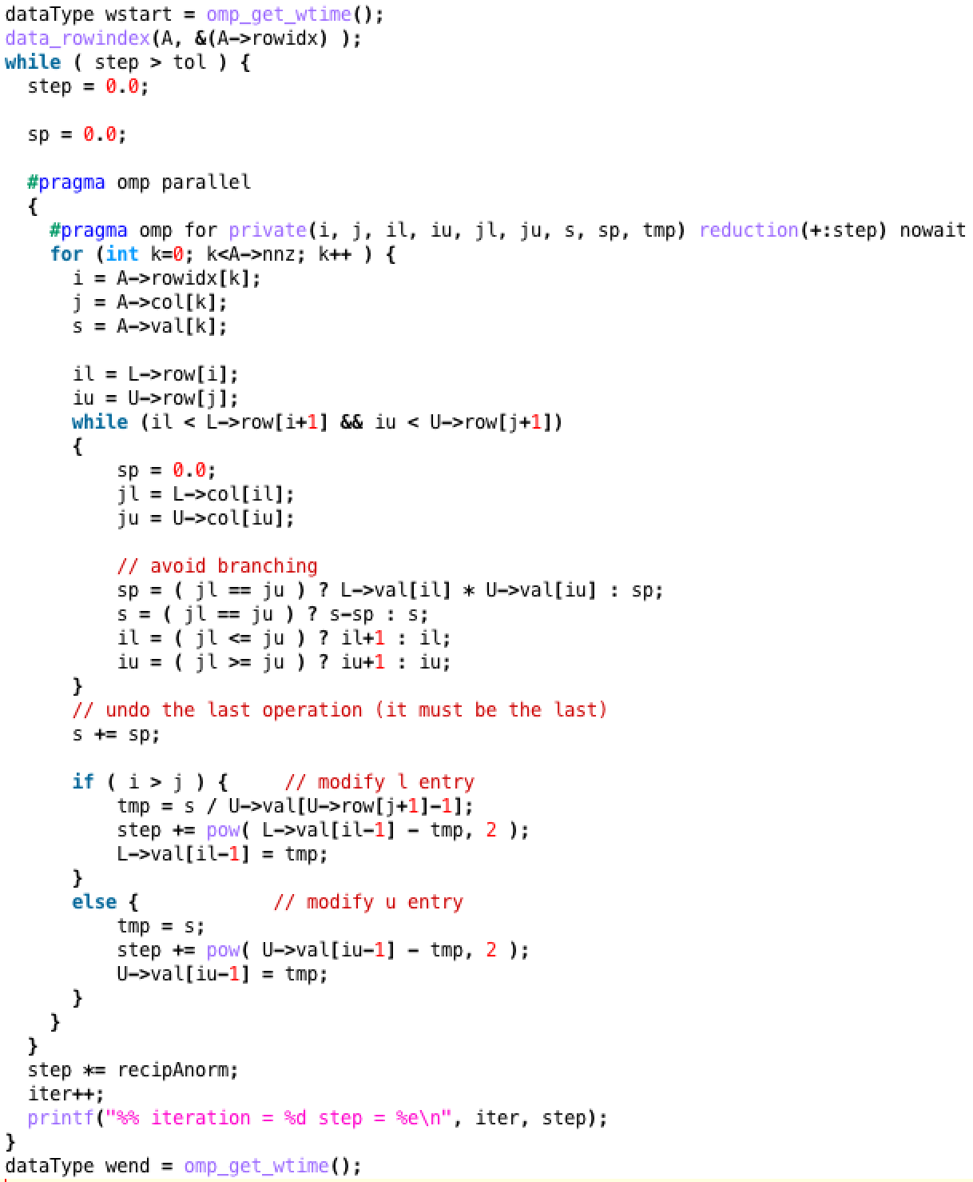
Sparse Implementation
Traditional CSR access
Direct non-zero access

Slide 35
Sparse Implementation
Traditional CSR access
Direct non-zero access

Slide 36
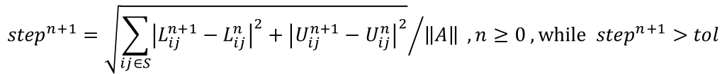
A(0) Preconditioner Generation Time
Iterations
14 10 27 19 53 40 51 33 57 36 47 37
$${step}^{n+1}={\sqrt{\sum_{ij∈S}{{\left|L_{ij}^{n+1}−L_{ij}^{n}\right|}^{2}+{\left|U_{ij}^{n+1}−U_{ij}^{n}\right|}^{2}}}}/{\left\|A\right\|} , n≥0 , while {step}^{n+1}>tol$$

Slide 37
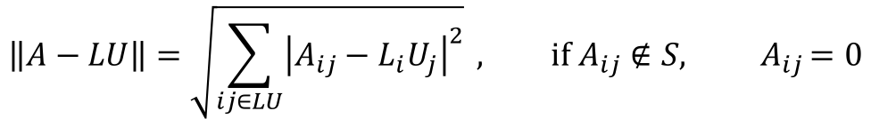
A(0) Residual
$$\left\|A−LU\right\|=\sqrt{\sum_{ij∈LU}{{\left|A_{ij}−L_{i}U_{j}\right|}^{2}}} , if{ A}_{ij}∉S{, A}_{ij}=0$$

Slide 38
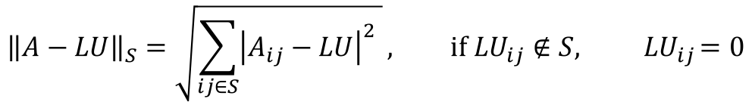
A(0) Non-linear Residual
$${\left\|A−LU\right\|}_{S}=\sqrt{\sum_{ij∈S}{{\left|A_{ij}−LU\right|}^{2} }}, if{ LU}_{ij}∉S{, LU}_{ij}=0$$

Slide 39
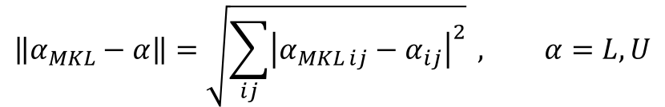
A(0) Residual Comparison
$$\left\|α_{MKL}−α\right\|=\sqrt{\sum_{ij}{{\left|α_{MKL ij}−α_{ij}\right|}^{2}}} , α=L, U$$
 |  |  | Time [s] | iterations | Residual | non-lin residual | L-diff residual | U-diff residual
CPU | 16 | MKL | 0.854358 |  | 1.30E+02 | 2.69E-13
 |  | ParILU tol 1e-15 | 0.744124 | 14 | 1.30E+02 | 2.69E-13 | 1.38E-11 | 2.46E-13
 |  | ParILU tol 1e-1 | 0.486821 | 10 | 1.30E+02 | 2.90E-04 | 3.00E-01 | 2.25E-04
 | 32 | MKL | 1.307835 |  | 1.30E+02 | 2.69E-13
 |  | ParILU tol 1e-15 | 0.830351 | 27 | 1.30E+02 | 1.16E-11 | 1.58E-09 | 6.54E-12
 |  | ParILU tol 1e-1 | 0.542718 | 19 | 1.30E+02 | 2.18E-03 | 5.74E-01 | 1.12E-03
KNL | 68 | MKL | 1.594836 |  | 1.30E+02 | 2.69E-13
 |  | ParILU tol 1e-15 | 1.621562 | 53 | 1.30E+02 | 1.05E-09 | 2.52E-07 | 5.85E-10
 |  | ParILU tol 1e-1 | 1.161366 | 40 | 1.30E+02 | 7.02E-03 | 2.23E+00 | 2.97E-03
 | 136 | MKL | 1.722214 |  | 1.30E+02 | 2.69E-13
 |  | ParILU tol 1e-15 | 1.144376 | 51 | 1.30E+02 | 1.63E-09 | 1.89E-07 | 1.08E-09
 |  | ParILU tol 1e-1 | 1.021996 | 33 | 1.30E+02 | 2.93E-03 | 1.20E+00 | 9.62E-04
 | 204 | MKL | 1.828752 |  | 1.30E+02 | 2.69E-13
 |  | ParILU tol 1e-15 | 1.232995 | 57 | 1.30E+02 | 2.96E-08 | 4.88E-08 | 1.13E-09
 |  | ParILU tol 1e-1 | 0.783204 | 36 | 1.30E+02 | 1.62E-02 | 4.02E+00 | 7.13E-03
 | 272 | MKL | 1.861814 |  | 1.30E+02 | 2.69E-13
 |  | ParILU tol 1e-15 | 0.960091 | 47 | 1.30E+02 | 7.31E-09 | 1.64E-07 | 7.14E+02
 |  | ParILU tol 1e-1 | 0.766082 | 37 | 1.30E+02 | 1.24E-02 | 2.07E+00 | 3.85E-03

Slide 40
A(0) Maximum Difference
 |  | iterative tolerance | iterations | max(fabs(L_diff)) | max(fabs(U_diff))
CPU | 16 | 1.00E-15 | 14 | (185838,185144) 5.973139e-12 | (211628,211628) 4.973799e-14
 |  | 1.00E-01 | 10 | (147363,145499) 1.004476e-01 | (149150,149154) 6.445126e-05
 | 32 | 1.00E-15 | 27 | (179323,178549) 6.233827e-10 | (179320,179324) 2.319149e-12
 |  | 1.00E-01 | 19 | (152533,150869) 1.262095e-01 | (152650,152652) 2.219125e-04
KNL | 68 | 1.00E-15 | 53 | (171988,171104) 1.015414e-07 | (171990,171994) 2.522851e-10
 |  | 1.00E-01 | 40 | (153023,151404) 5.811655e-01 | (154245,154246) 7.124502e-04
 | 136 | 1.00E-15 | 51 | (182228,181549) 5.637994e-08 | (182255,182269) 3.218570e-10
 |  | 1.00E-01 | 33 | (149693,149684) 3.989369e-01 | (155721,155721) 1.463213e-04
 | 204 | 1.00E-15 | 57 | (175553,174732) 1.891136e-07 | (175550,175553) 1.077921e-09
 |  | 1.00E-01 | 36 | (147588,147494) 1.209293e+00 | (147490,147492) 1.293222e-03
 | 272 | 1.00E-15 | 47 | (184378,183689) 8.294235e-09 | (181805,181808) 2.140380e-10
 |  | 1.00E-01 | 37 | (157223,155784) 8.470096e-01 | (157230,157231) 6.903320e-04

Slide 41
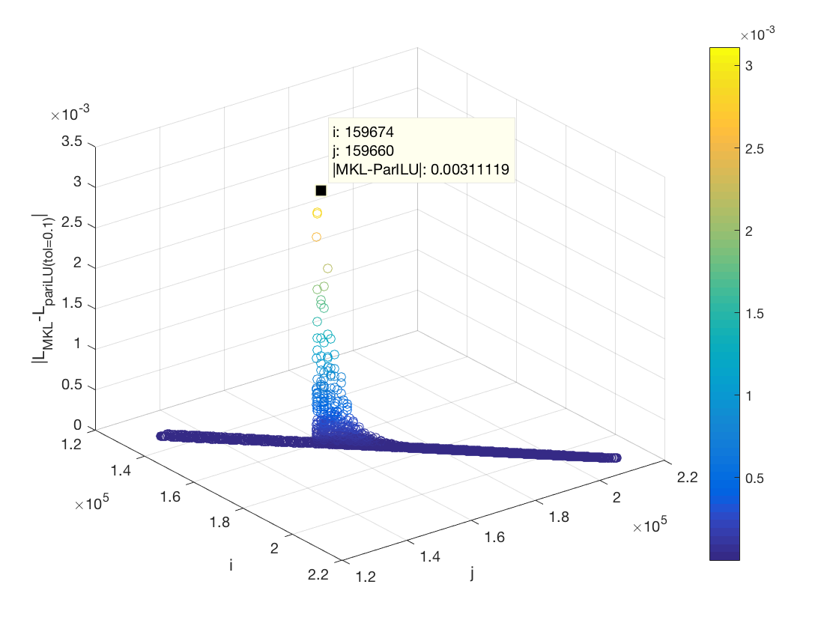
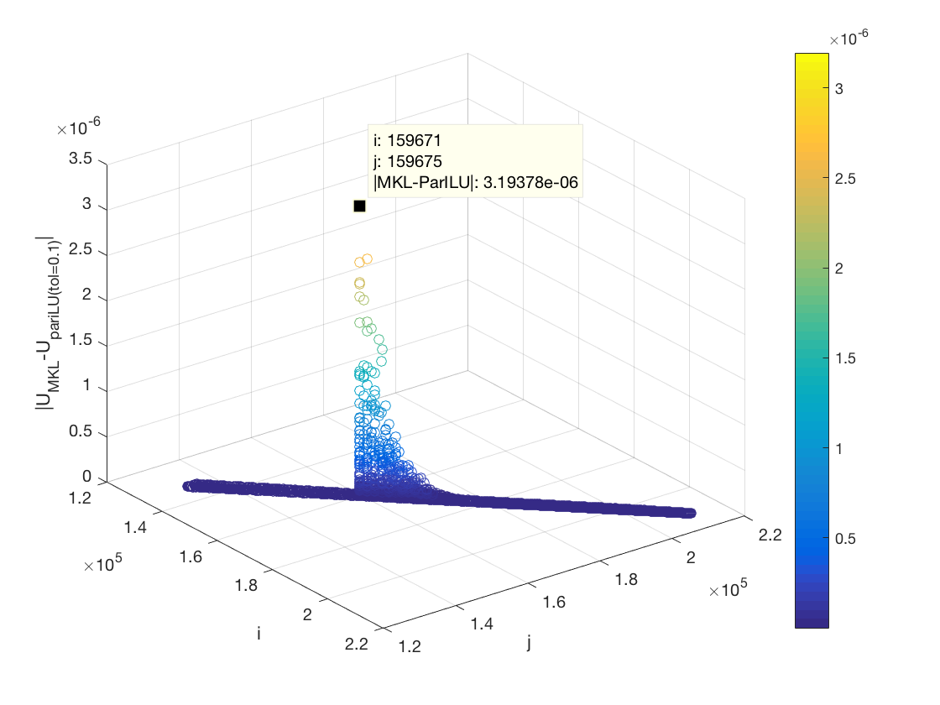
A(0) Maximum Difference

Slide 42
Summary of Sparse A(0) Factorization
 | Threads |  | Time [s] | Speed up vs MKL
CPU | 16 | MKL | 0.854358
 |  | ParILU tol 1e-15 | 0.744124 | 1.148139289
 |  | ParILU tol 1e-1 | 0.486821 | 1.754973594
 | 32 | MKL | 1.307835
 |  | ParILU tol 1e-15 | 0.830351 | 1.575038749
 |  | ParILU tol 1e-1 | 0.542718 | 2.409787403
KNL | 68 | MKL | 1.594836
 |  | ParILU tol 1e-15 | 1.621562 | 0.983518361
 |  | ParILU tol 1e-1 | 1.161366 | 1.37324151
 | 136 | MKL | 1.722214
 |  | ParILU tol 1e-15 | 1.144376 | 1.504937188
 |  | ParILU tol 1e-1 | 1.021996 | 1.685147496
 | 204 | MKL | 1.828752
 |  | ParILU tol 1e-15 | 1.232995 | 1.483178764
 |  | ParILU tol 1e-1 | 0.783204 | 2.334962538
 | 272 | MKL | 1.861814
 |  | ParILU tol 1e-15 | 0.960091 | 1.939205763
 |  | ParILU tol 1e-1 | 0.766082 | 2.430306416
ParILU factorization within MAGMA-sparse enables fine-grained parallelism
Residuals indicate the asynchronous execution is stable
Path to coarsening MPI level parallelism from cores to nodes is open

Slide 43
Influence on MKL’s GMRES A(0)

Slide 44
Influence on MKL’s GMRES A(1)

Slide 45
Influence on MKL’s GMRES A(2)

Slide 46
Influence on MKL’s GMRES A(3)

Slide 47
Influence on MKL’s GMRES
32: 3, 208, 22.2s
272: 9, 241, 51.2s
32: 1, 355, 49.5s
272: 1, 429, 114.0s
32: 3, 158, 16.6s
272: 1, 331, 95.6s
32: 3, 100, 10.7s
272: 9, 119, 29.7s
Threads: PariLU iterations, GMRES Search Directions, Total Time

Slide 48
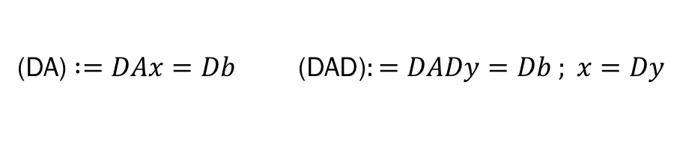
Scaling Influence on MKL’s GMRES
(DA) $:=DAx=Db$ (DAD)$:=DADy=Db ; x=Dy$

Slide 49
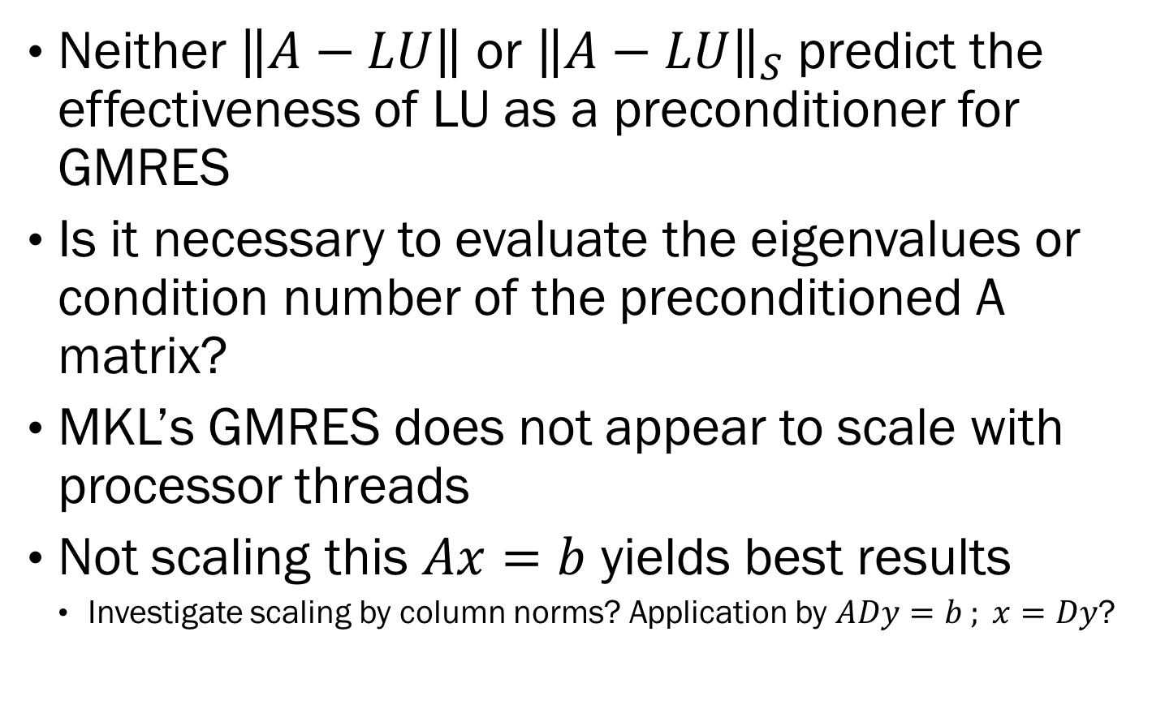
Summary of PariLU factorization’s influence on MKL’s GMRES
Neither $\left\|A−LU\right\|$ or ${\left\|A−LU\right\|}_{S}$ predict the effectiveness of LU as a preconditioner for GMRES
Is it necessary to evaluate the eigenvalues or condition number of the preconditioned A matrix?
MKL’s GMRES does not appear to scale with processor threads
Not scaling this $Ax=b$ yields best results
Investigate scaling by column norms? Application by $ADy=b ; x=Dy$?

Slide 50
Future work
Software
Thread parallel Tri-solver
Thread parallel GMRES
Block Compressed Storage PariLU
Strength of Connection (Lines) based fill
Efficient metric preconditioning effectiveness
Boundary Element Method Applications
Hardware
Sky Lake Processor
KNL Leverage Boot
Knights Hill

Slide 51
Questions
Thank you for your considerate attention.
Any thoughts, questions, or comments?

Slide 52
Influence on MKL’s GMRES A(0)

Slide 53
Influence on MKL’s GMRES A(1)

Slide 54
Influence on MKL’s GMRES A(2)

Slide 55
Influence on MKL’s GMRES A(3)

Slide 56
Influence on MKL’s GMRES
32: 1, 355, 49.5s
272: 1, 429, 114.0s
32: 3, 208, 22.2s
272: 9, 241, 51.2s
32: 3, 158, 16.6s
272: 1, 331, 95.6s
32: 3, 100, 10.7s
272: 9, 119, 29.7s

